Slide 1
AI Recruiter Chatbot
Team Tech Vanguard

Slide 2

Project Brief
Project Title:
AI Recruiter Chatbot

Slide 3
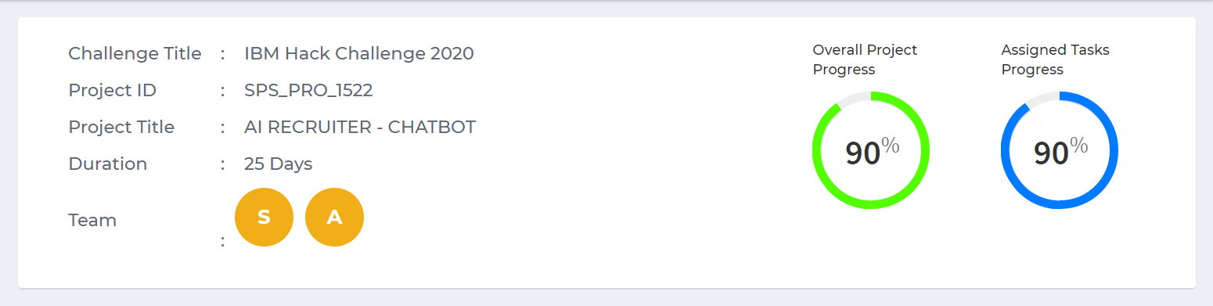
Duration and Details
Team members :
Akansha Thakarke
Swapnaja Wattamwar

Slide 4

Description
AI Recruiter Chatbot, is a platform where the Bot shortlists the eligible candidates for Interview after chatting with them and analyzing their Education, work experience, skills, personality traits, etc. The details of the shortlisted candidates will be sent to the recruiter after which the company can communicate with him about the further procedure.

Slide 5
MILESTONES
UI creation
Storage
Chatbot making
Bot Training
Adding Novelties

Slide 6
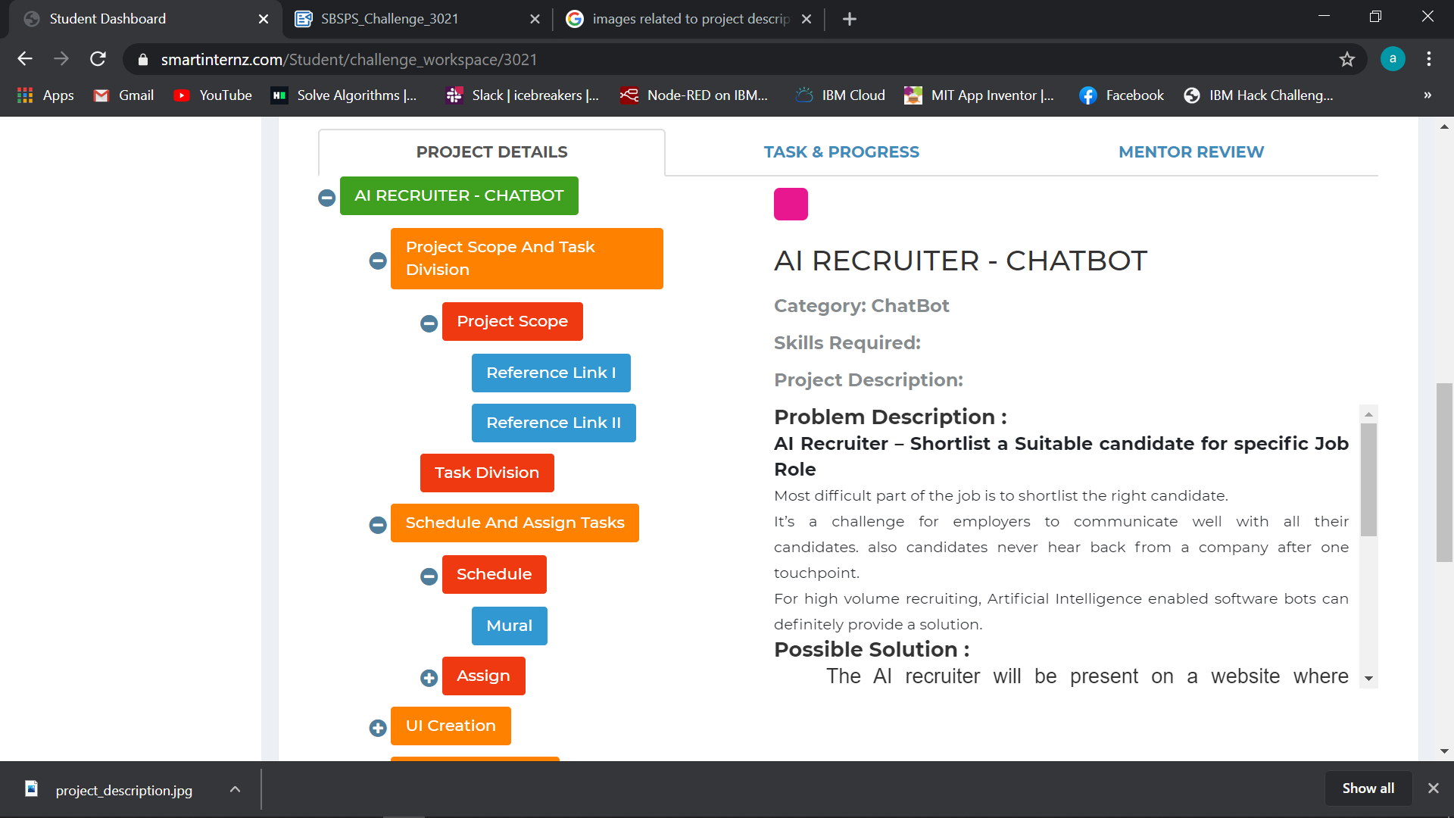
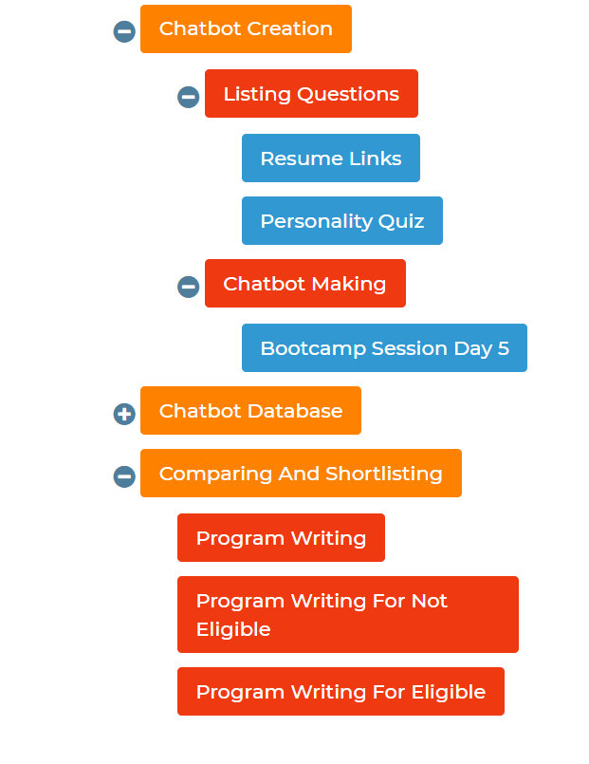
FLOW

Slide 7
Working
In this project the initial step is that the candidate will register themselves. After successful registration they have to select the desired job role. After selection of job roles they will be chatting with the chat bot and the chat bot will shortlist them if they are eligible. After shortlisting they have to fill the confirmation form which will automatically send their details to the interviewer.

Slide 8
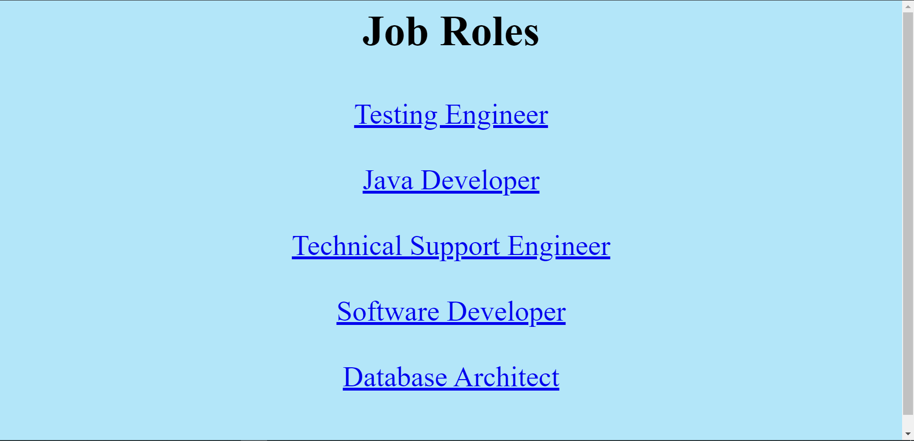
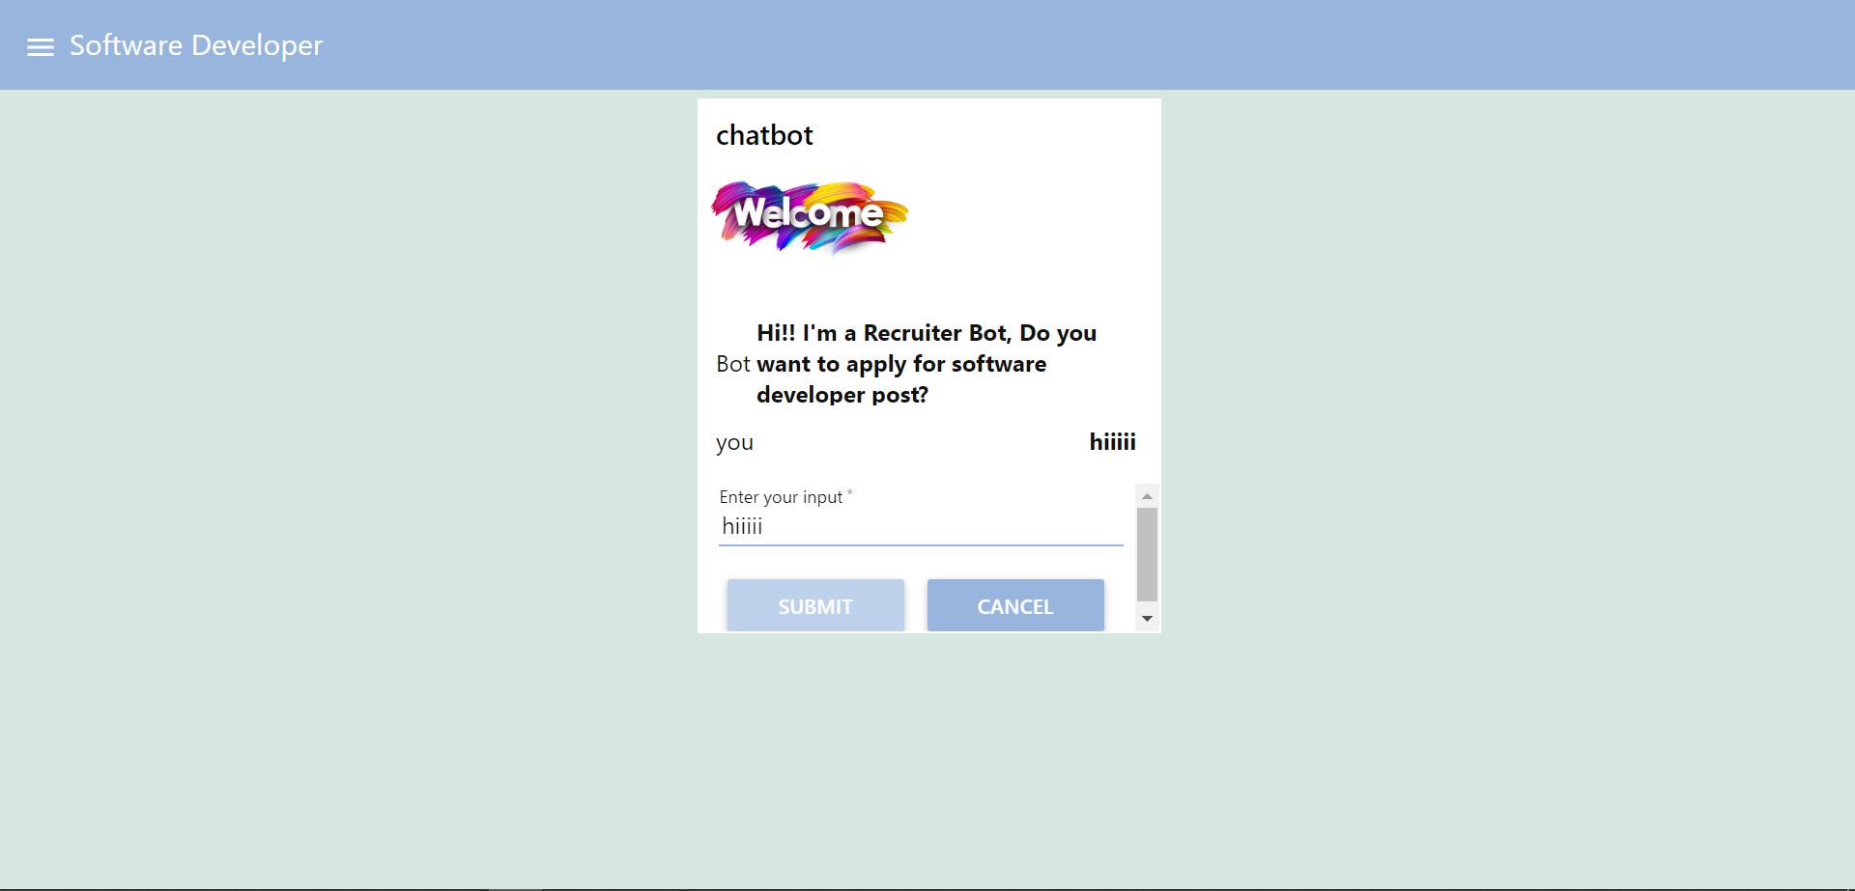
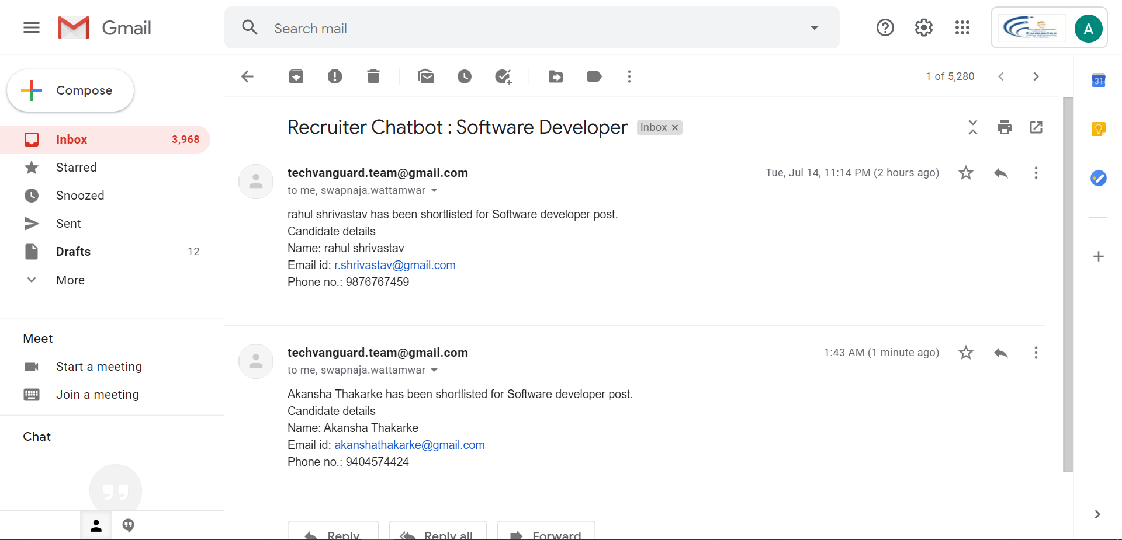
Few snapshots of flows and UI’s
Chatbot UI
Email received!!

Slide 9
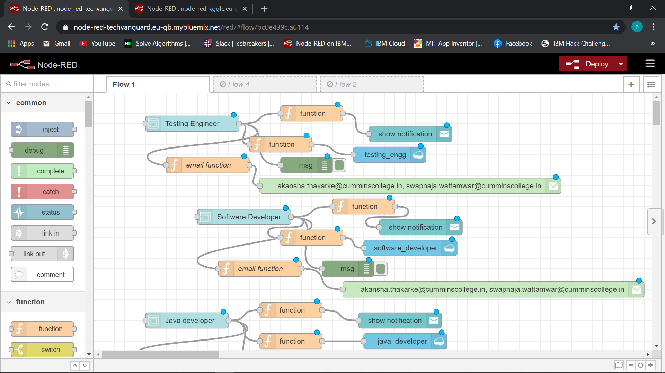
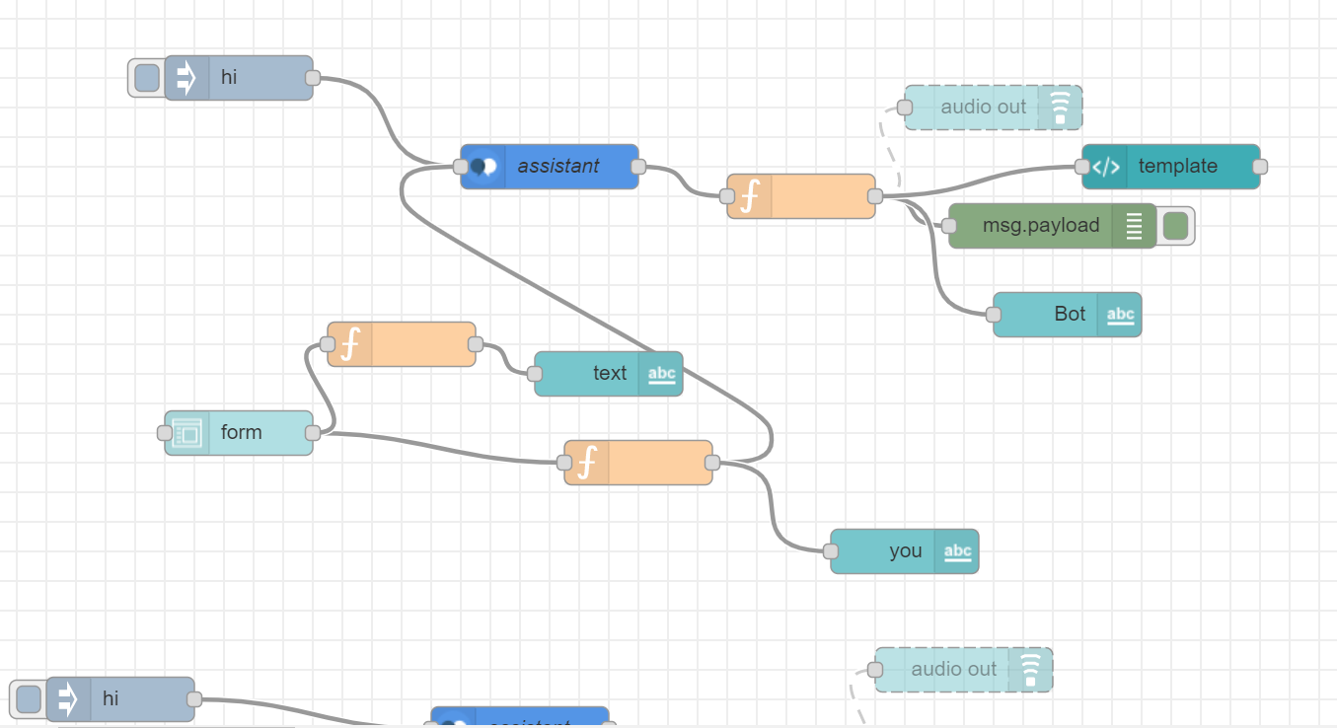
Confirmation form network
Chatbot network for UI

Slide 10


Need and Scope
This AI Recruiter will work as a significant tool for mass recruiting.
The initial selection process will be completed easily with this without much human intervention.

Slide 11

Need and Scope
A large number of candidates can connect with various companies and apply for a job.
The candidates will be made aware
of their eligibility and capability.

Slide 12

Novelties
Candidates get options of various job opportunities depending upon their eligibility.
Recommendation of required skills.
Interviewer automatically receives Required details of shortlisted candidates

Slide 13


Technology Stack
Initially Cloudant is to be used as a Database to store and manage data of all registering candidates, Job Roles and their requirements.
All the forms, pages are created and connected to the Cloudant using HTML, CSS, and Node-red etc.
IBM Watson Assistant is used for the creation of an interactive chatbot with AI technology, its UI is created using network of multiple nodes in the Node-red.

Slide 14
Eligible candidate will get shortlisted
IMPACT
Efficient way of shortlisting
Less manual errors

Slide 15
The End

